Slide 1
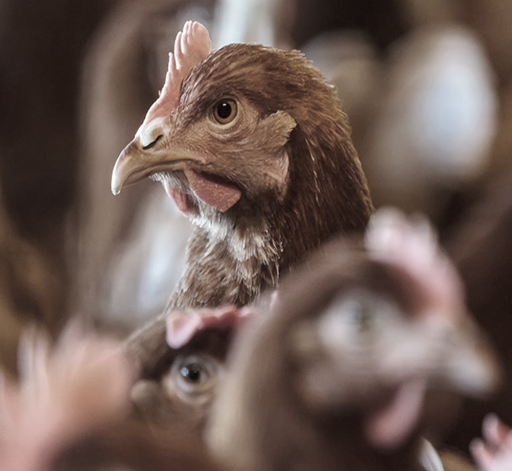
AGRO United Engineering
Your production partner

Slide 2


Welcome to Agro United Engineering
With extensive industry experience and regional reach, our qualified team of professionals is able to bring you comprehensive assistance across our product range and your application categories. Together with our world leading Principals, we aim to deliver technical innovation, application technology, superior service and customer satisfaction.
To sustain our position as a market-leading distributor in the region,
We are excited about the markets and industries we service.
We are proud of our core values we aim to grow together with our clients
We are passionate about being our Customer's preferred business partner

Slide 3
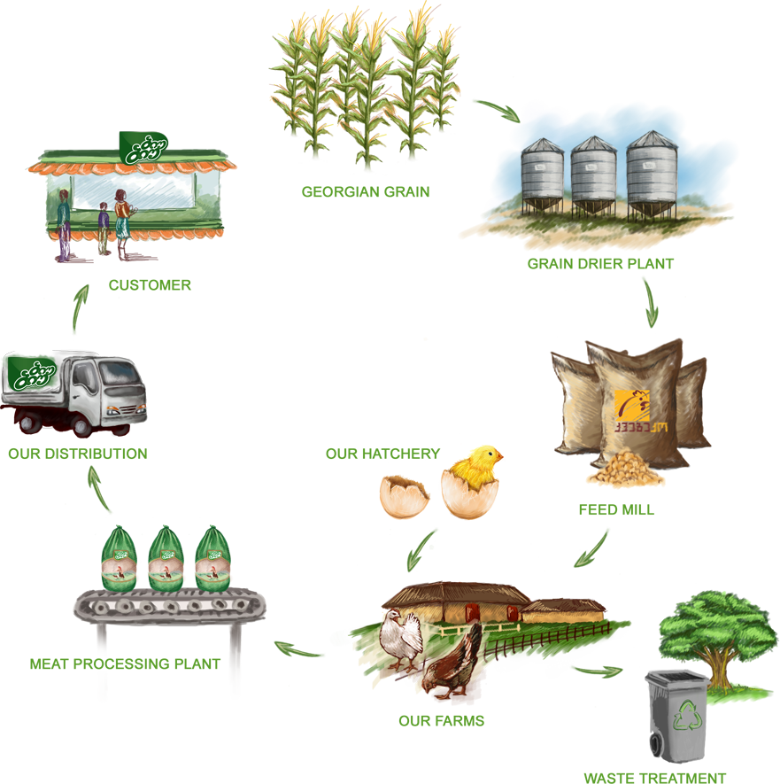
When combining our values ,experiences ,knowledge and network of reputable and fully and reliable manufactures, we are able to offer our valued clients turn –key intergraded projects which can include the following
Animal farms (Poultry , Dairy) Feed Mills
Slaughterhouse and Processing Plants Hatchers
Waste management (composting system, Rendering System
Biogas, Water treatment)
We offer for our client the following services:
Consultation services:
Feasibility studies
Project design
Third-party auditing
Structures ,equipment selection
Implementation services:
Erection,Installation , Commissioning ,Training and Quality control

Slide 4
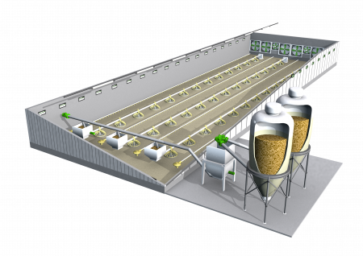
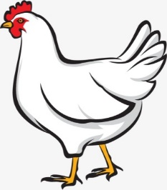

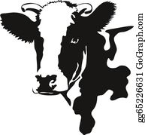
Agro Animal Farms
At Agro United Engineering company ,We specialized in
supplying wide range of complete solution for Agriculture sector:
Poultry
Breeder farms.
Broiler farms.
Hatchers.
Slaughterhouses.
Food processing plants.
Layer cages farms (egg production)
Dairy farms
Green houses: Hydroponic
Waste management

Slide 5
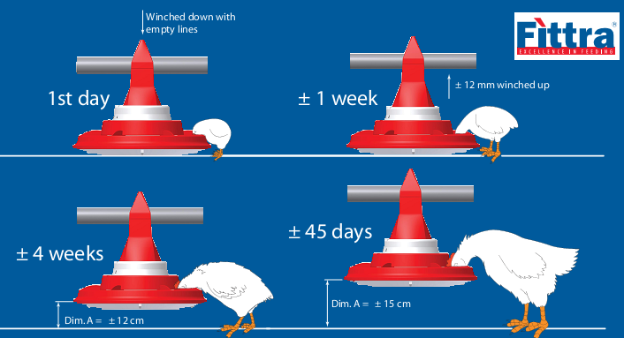
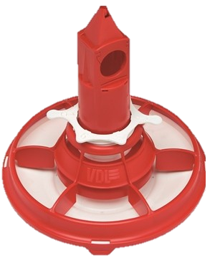
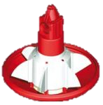
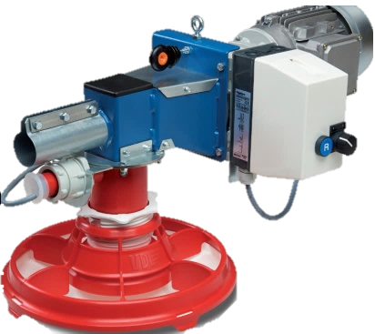
Our Equipments
Poultry
1.1-Broiler Equipments
Pan Feeding System :
Reliable and simply designed.
Enhances performance.
Assuring high feeding efficiency.
Reduce OPEX and fast ROI
It’s Features:
The spiral feeding line is complete with stainless steel drives units.
Stainless steel load hopper with electronic limit switch.
Stainless steel Intermediate limit switch positioned over the pan.
A special dispensing system which avoids wasting any feed.
Our pan is made of special tough and version plastic.
It is impact-proof & extremely resistant for the cleaning products.
The pan is easy to mount, dismount and clean.
The control of feed level is so easy for each single pan and the feed is evenly distributed.
Our pan is composed of five different elements.

Slide 6
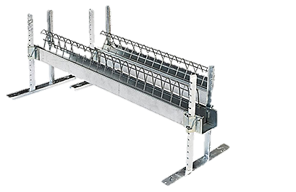
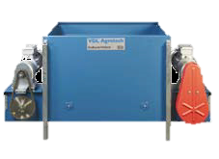
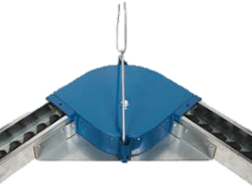
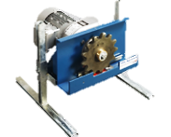
1.2-Breeder Equipment
Chain Feeding System
Our chain feeding system is designed to ensure the excellent feed flow then even feed distribution and same feed access for all birds. More egg production and the best feed conversion will be attained with our system.
Robust and durable system due to the highest quality of materials, while as for the operation efficiency will be to the highest level based on a unique design and technical features.
It’s Features:
Stainless steel drive units for our chain conveyor complete with gear motor.
Reinforced-fiberglass casing that completely encloses the drive unit.
Loading hopper with spiral actuated by chain.
Stainless steel load hopper with cover and reinforced fiberglass silo connection.
Corners 90° both aluminum and plastic.
Electrical board for automatic control of the equipment.

Slide 7
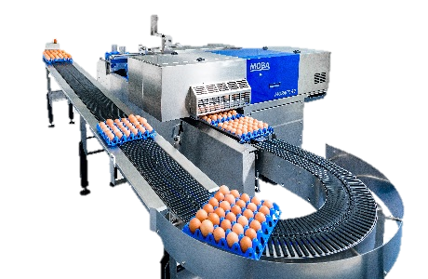
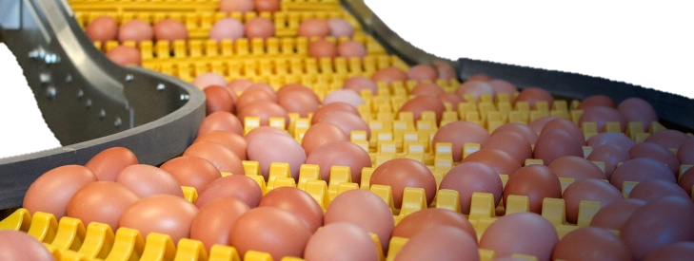
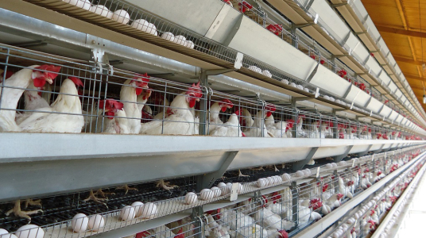
1.3-Cage system
Rearing system which gives layers the optimal start in the conventional cage system
Production cage system for optimal laying performance.
Egg collection system
Control panel for feeding system
Control panel for egg system
Control panel for light system
Central manure removal and cleaning system
Egg cross conveyor
Service trolleys
Lighting system
Manure cross conveyor
Main water supply accessories
Feed auger
Silo
Feed weighing system
Ventilation and control system

Slide 8
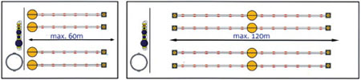
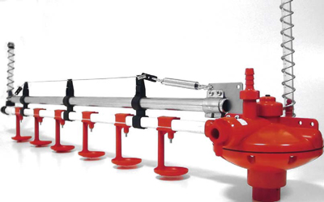
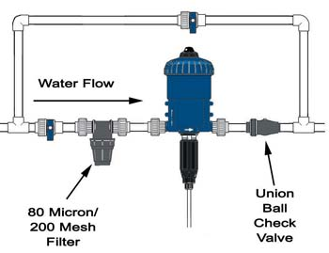
1.4-Drinking System
A complete watering system.
Providing for large healthy birds and dry floors.
High quality of Stainless steel is used.
Available with or without drip cups.
Every system is backed by our generous warranty program, and personal commitment to client’s satisfaction.
Our drinking solution means healthy birds and efficient operation, It consists of drinking elements, pressure regulators, flush breather, suspension material, Main water supply and Water pressure regulator.
Guarantees correct water pressure and water delivery.
End set consists of transparent vent tube and flushing valve.
Water pressure can be checked from vent tube.
Water control panel.
Complete with water meter, pressure regulator with gauges ,filter and by-pass.
Connection for mediator.

Slide 9
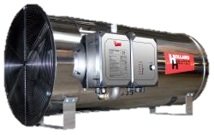
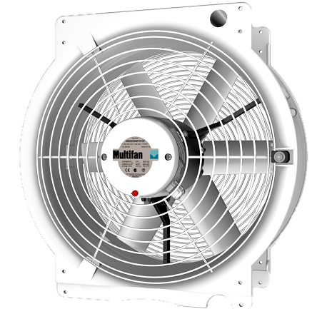
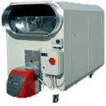
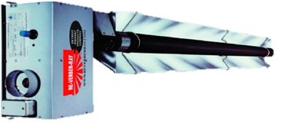
1.5-Heating Systems
Direct or Indirect Air Heaters:
Operated using Gas/Diesel.
Available as hanging, mobile and fixe
Safe and reliable.
Pre-painted galvanized steel frame.
Made with first quality materials, designed to last long for grant maximum efficiency.
Ready to use and equipped with all necessary attachments.
100% Stainless steel combustion chamber and heat exchange.
Wide cover for a complete cleaning.
Infra Red Heaters
Is the best for poultry and agricultural applications.
Air Mixer
To eliminate all expected problems of relative humidity increase,CO2,etc.
To assure the right heat distribution

Slide 10
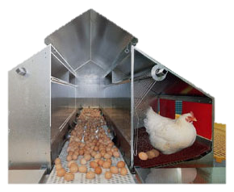
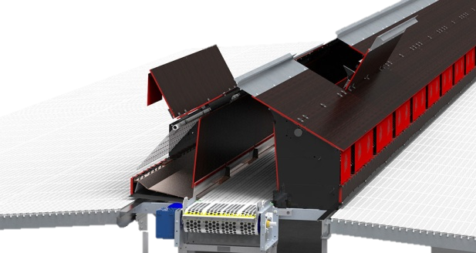
1.6- B-Premium & Laying nest
The Premium+® laying nest is designed to produce premium-quality hatching eggs. The hatchability rate of eggs is high thanks to the preserved eggshell quality. Eggs stay perfectly clean and the correct handling of the eggs avoids damages. The Premium+ laying nest also reduces the amount of floor eggs to a minimum because of the high nest acceptance among birds.
It’s Features:
HIGH ACCEPTANCE AND OPTIMAL DENSITY.
HIGH HATCHABILITY RATE AND OPTIMAL HYGIENE.
EASY MANAGEMENT AND INSTALLATION.

Slide 11
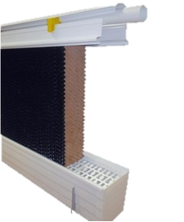
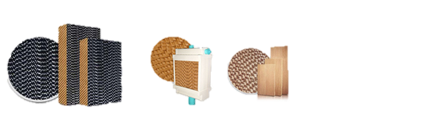
1.7-Cooling System
COLD MAKER is a modular PVC Pad Frame System designed for poultry cooling and greenhouse cooling systems. It is an innovating pad frame system with minimum installation needs
It’s Features:
Easy installation
Includes an internal water tank, no need for external water tank
The floating system allows automatic water refilling when the water level falls
Adjustable length and height due to its modular structure
The pads can be easily installed and uninstalled due to the special lock system
In systems up to 18m, the pump is installed in the head section. In the middle for longer systems.
System includes a drain valve for cleaning at the end of cycle.
The pumping system has a capacity of 0.37 kW 12 m3/hr in systems up to 36m.
PVC raw material is anti-UV loaded
Completely rustproof system
More durable than alternative metal frame cooling systems as it is completely made of plastic

Slide 12
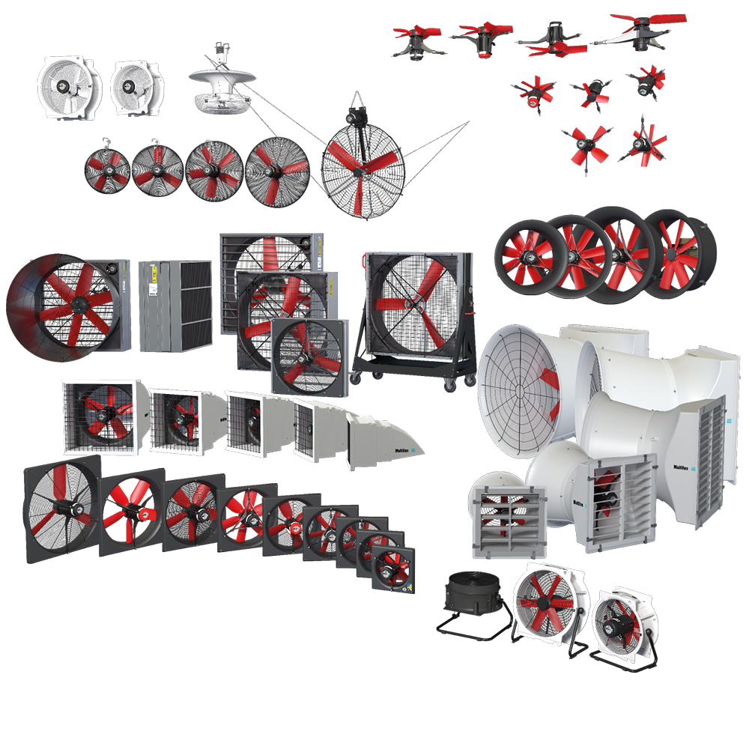
1.8 - Ventilation System
At Vostermans Ventilation, we manufacture a wide range of Multifan fans which are specifically designed for agricultural and
industrial applications. Known worldwide as being energy efficient and very reliable, the Multifan is the right choice if you’re looking for a ventilation solution you can count on
It’s Features:
Low energy consumption.
All parts can be recycled.
Low level of maintenance and long-life cycle.
Different varieties and mounting positions.
Low noise level.
Different models and different capacities can be supplied

Slide 13
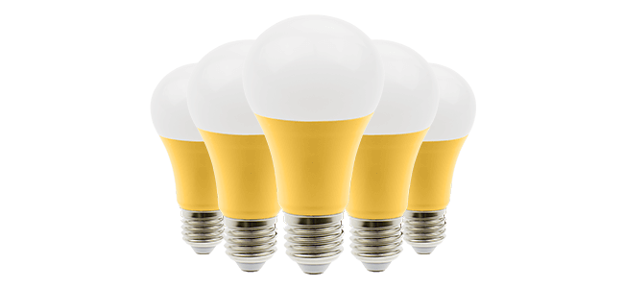
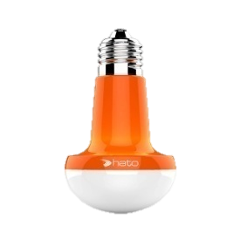
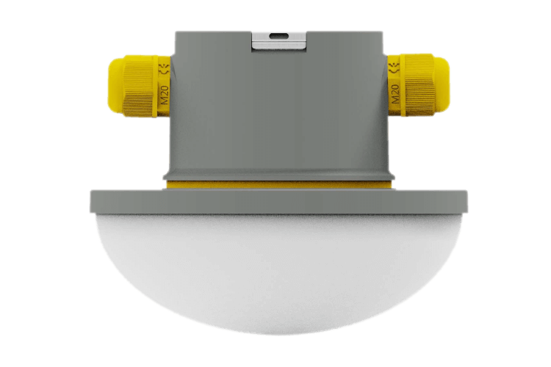
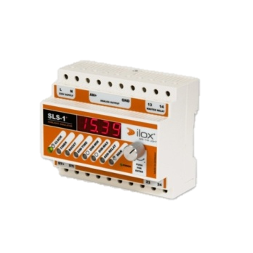
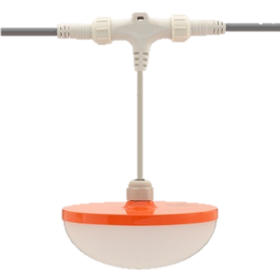
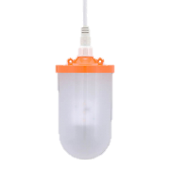

1.9-Lighting systems
Durable lighting solutions for the agricultural sector
Our light is Perfectly designed for BREEDER, BROILER, LAYING HENS Houses , MUSHROOM house, CATT. It has no fluctuation issues and guarantees a perfect LIGHT climate. We took great care in the look and Feel of this light to ensure a maximum animal welfare.
It’s Features:
100% dust and airtight, no influence of ammonia.
Watertight to 1 meter below water (IP67)
Dimmer capability of lights from 100% down to 0.0%.
LED Lamps Very low energy consumption.
48-96 VDC (safe installation).
7-15W.
60,000-hour lifetime.
0 – 100% dimmable.
Flicker free, maximum animal welfare.

Slide 14
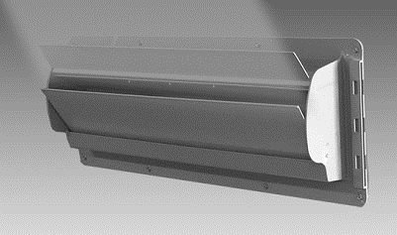
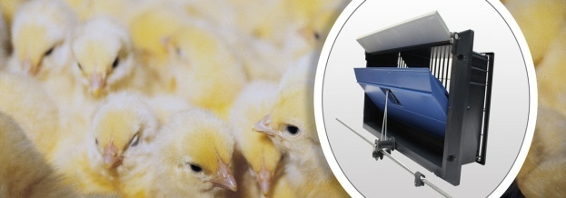
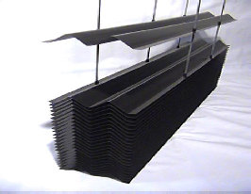
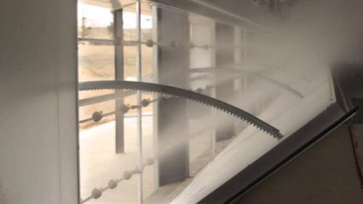
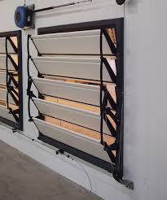
1.10-Air Inlets & Light Traps
The importance of air inlets is often underestimated. The air inlet is the most important part of every ventilation system. Without proper air inlets, no ventilation system can function satisfactorily. Air inlets are responsible for providing fresh air throughout poultry house and for maintaining a fast inlet air velocity so that good air mixing occurs, providing adequate air circulation. Double L inlets are structured to take warm air from the attic to heat the living area of the poultry house. The poultry inlets help to keep your air clean, lower your heating costs, and improve litter quality.
1.Static Pressure Air Inlet
Our Air Inlets feature patented counterbalanced louvers that open from the TOP instead of the bottom. Air is directed towards the peak of the house, utilizing the heat collected at the peak. Eliminates curtain and baffle pulley and cable management NOT required with Static Pressure Air Inlet.
2.Motorized Poultry Air Inlets
The inlet casing is made from high-quality plastic and is therefore resistant to minor displacements of the brickwork. SKOV wall inlets open via pull rod and are held closed by powerful springs ensuring precise closing functionality in all types of weather, including very cold periods.
3.Light Traps
Made of high quality and resistance material which assure the right reduction performance of light.
4.Rack & Pinion
​Rack & Pinion is a strong and stable system with a good, solid closing mechanism making for a tight door. Rack & Pinion tunnel opening is installed directly in the house wall with cooling pads.
5.Tunnel Door Light
Tunnel Door Light is ​a flexible, lightweight system adaptable to most wall thicknesses and door materials. SKOV supply mounting sets to ensure that the air inlet works perfectly.

Slide 15
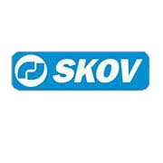
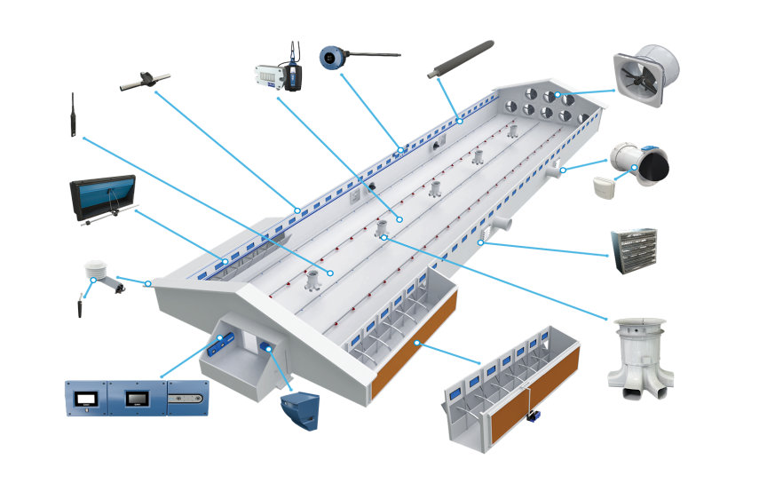
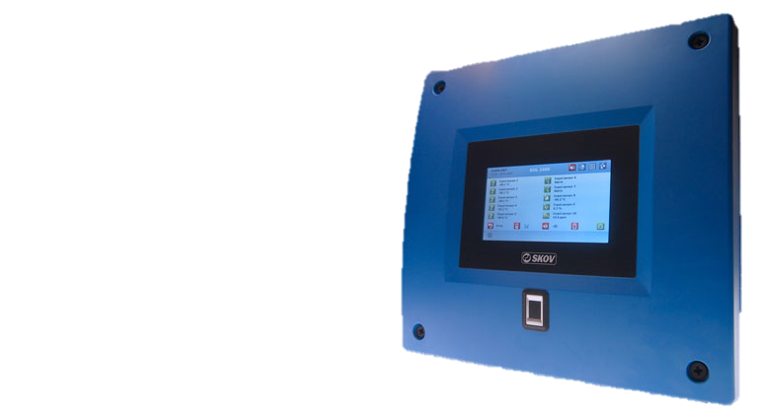
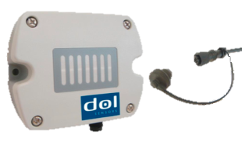
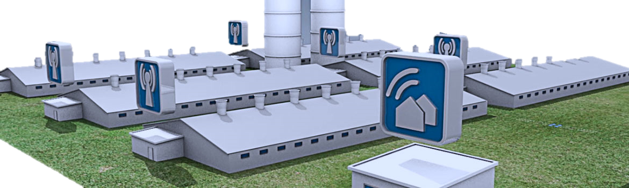
1.11-Control System
Improving animal performance and optimizing your business operations is much easier with the complete automation solutions. With our controller you are able to control and monitoring of animal housing processes.
Ventilation.
Humidity.
Heating.
Cooling.
Bird weighing.
Feed and water consumption.
Lighting.
Alarm system.
Egg counting
We translate this knowledge into solutions that will increase your livestock production and profit.

Slide 16
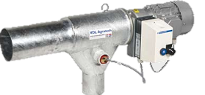
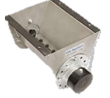
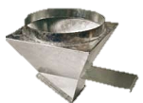
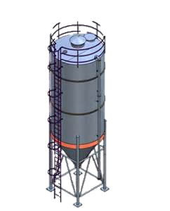
1.12- Feed silos | Bins
Perfectly sealed off silo for secure storage
Feed remains fresh
User-friendly
Centre less auger prevents feed de-mixing
Durable material for long life
Pneumatic filling
The silos are filled by a bulk truck equipped with pneumatic filling system.
For this purpose, the silo is equipped with special steel filling pipe and a PVC de-aeriation pipe. The system has been designed to prevent feed de-mixing during filling and to fill the silo to the maximum level.
Mechanic filling
The silo is equipped with a remote opening mechanism for opening and closing of the silo roof lid. For mechanic filling VDL offers a rigid auger filling system, optionally available with movable support for multiple silo use.
Pneumatic- mechanic filling
Pneumatic- mechanic filling combines the advantages of both filling systems.
Capacity m³ (3.9- 39.8)

Slide 17
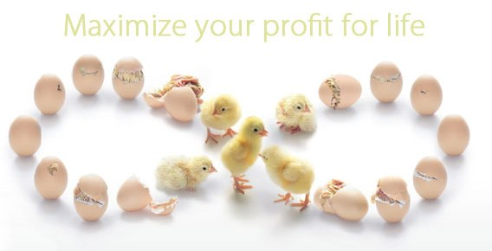
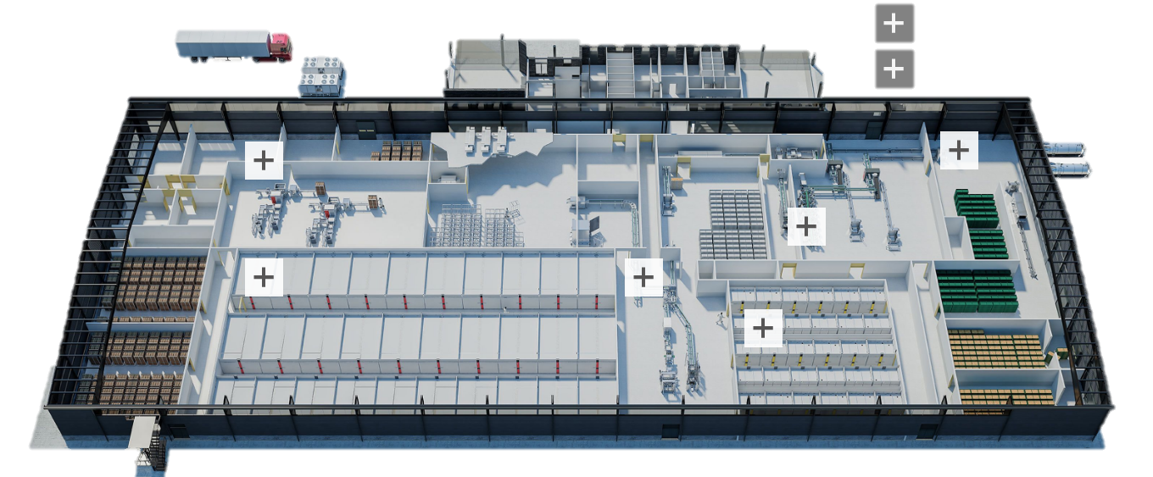
Hatcher
All Solutions:
Egg handling
Incubation
Candling and transfer
Hatching
Chick handling
Washing and waste handling
Climate control
Process control

Slide 18



Feed Mills
Design, manufacture and sale of high-quality products in the agricultural segment.
Comprehensive investment handling.
Full Automation of the feed production process.
Mills. Mixers.
Micro Dosing. Conveying equipment.
Feed silos. Cleaners.
Flex Mix automation. Pellet Mills.
Feeders and Conditioners. Hammer Mills.
Heat Treatment. Roller Mills.
Flakers. Coolers.
Crackers. Crumplers.
Mechanical briquetting presses.
Metal scraps briquetting presses.
Metal sludge hydraulic briquetting presses.

Slide 19
Slaughterhouse
WEIGHING & MEASUREMENT
  QUALITY GRADING SYSTEM
  MLOGIC DISTRIBUTION MANAGER M5
  FLEX GRADER M1.0
PACKAGING & DISPATCH
  BIRD BAGGING MACHINE
  TRUSSING MACHINE
TRANSFER & CONVEYORS
  RM1200 REHANGER
  SYNCOM REHANGER
  CARTTON freezer
  Carton freezer -35C
  sorting and palletization -5 C
  Automatic pallet storage -20C
  PALLET supply for truck distribution -5C
  BY PRODUCT HANDLING
  FEATHER PRESS
  OFFAL SEPARATOR
  CRUSHER
LIVE BIRD HANDLING
  CRATE SYSTEM
  DRAWER SYSTEM
  CONTAINER SYSTEM
  MULTISTAGE CO2 STUNNING SYSTEM
SLAUGHTERINGKILLER
  BIRD COUNTER VISION M1.0
  ELECTRICAL STIMULATOR
  JET STREAM SCALDER
  PLUCKER
  TAIL FEATHER PULLER
  HEAD PULLER
  HOCK CUTTER
  FEET CUTTER
  FOOTPAD INSPECTION SYSTEM
CHILLING
  IMMERSION CHILLING
  SPRAY CHILLING
  AIR CHILLING
  MOISTENING SYSTEM
  GIBLET CHILLING
EVISCERATION
  VENT CUTTER
  OPENING MACHINE
  FAT RETENTION MACHINE
  MAESTRO EVISCERATOR
  CROPPING MACHINE
  NECK BREAKER
  FINAL INSPECTION MACHINE
  INSIDE/OUTSIDE BIRD WASHER
  MAGS AUTOMATIC GIBLET HARVESTING SOLUTION

Slide 20





Dairy Farms
Dairy Farm Equipment And Accessories
As a quality focused firm, we are engaged in offering a high quality range of Dairy Farm Equipment And Accessories.
FODDER TABLE BARRIER
GATES, DROVE BARRIERS
COMBING BRUSHES
Milking Machines
Milking Parlor
Rubber Mats
Ventilation Fan
Cubicles
Water Trough
Fogger System
Cow Swinging Brush
Hoof Trimming Machine
Ear Tags
Milk Cans
Manure &waste management

Slide 21



Design and implementation of steel works
AGROUE is specialized in Pre-Engineered and structural Steel Buildings; our buildings are suitable for all types of structures such as Warehouses, Industrial factories, hangar, Poultry farms, Bulk storage buildings, Sheds, fuel stations and agricultural structures..
Liquid Storage Systems
liquid storage systems for almost any application:
Storage of potable and rainwater.
Storage of industrial liquids.
Agriculture, Farms, Plantations (Manure Storage).
Industrial Applications.
General Water Supply (residential or public use).
Fishponds at fish-hatcheries.
Schools, Hospitals, Fire Departments.
Army Camps, UN Organizations and its sister agencies (UNICEF…ETC.),Military operations.
Recreational/ Theme Parks, Hotels, Resorts.
Mega-mall, Shopping centers.
Offices, Factory Plants, Municipal Districts (theme parks, offices).
Housing Properties, Remote Working Sites.

Slide 22







Wastewater Treatment
When implementing the AGROUE Sustainable Poultry, Meat Processing and Agricultural Plant, all different kind of resources can be recovered from wastewater and manure, such as biofuel, animal fat, fertilizers, energy, heat and clean water to meet the industry sustainability requirements and standards for your (poultry) processing equipment. When realizing a complete turn-key wastewater, biogas and manure treatment plant, you can completely reduce your environmental footprint:
Reduce your wastewater surcharge cost and discharge water to sewer, river or sea.
Reduce your water intake costs.
Reuse water for agricultural and production process applications.
Recover resources and create the best and most economical business case.
Environmental Remediation Applications
Environmental Dredging
Agriculture
Industrial Wastewater
Processing
Mining and Mineral
Processing
Municipal Applications

Slide 23




Desalination System
Technology many of possibilities.
We change the Sea water , polluted water, to clean where it is needed.
Sea water ,The desalination module are designed for land use, can be fed directly from the sea or any beach well and will convert seawater or salty brackish water to pure fresh drinking water
1 unit has a capacity 30 – 200 m³/d of water. Energy consumption from 2.8kw/m³(30000ppmNaCl)
Polluted water, Container Water Treatment removes mechanical impurities, iron, manganese, water hardness, turbidity, bacteria, viruses, nitrates, pesticides, heavy metals, organic pollutants, colloidal substances and adjusts color, taste, smell and pH.
1 unit has a capacity 0.5 -10m3/h of water. Total input power 150w-6kw
Power input; can be connected to the electric network, generator or solar power supply.
It’s Features:
Long service life
Simple and quick installation
Reliable and proven components for harsh operating conditions
Energy consumption up to 65% lower than RO system
Fully automatic operation
Green energy ,no emissions ,noise ,no hazard
Design feed TDS max 45000ppmNaCL

Slide 24



Organic Waste (Compost)
Environmental pollution resulting from improper disposal of farms and slaughterhouses waste Here we talk about a solution to the most important environmental problems and provide appropriate solutions by converting this waste into high-quality organic fertilizer(compost)
These are just some of the types of organic waste that can be rapidly composted with the Bioreactor:
Dairy Manure Horse Manure
Poultry Manure Farms mortality
Food Waste Yard Waste
Fish Waste Wood Chips
Paper Biosolids
Cardboard Municipal solid waste
We have environmentally and socially acceptable solutions for organic waste disposal. Our mission is to provide high quality, cost-effective environmental solutions for organic waste disposal, we believes in our ability to reach our goals and success through effective communication, education and training.

Slide 25


Rendering plant
Supplying complete systems and equipment for the processing/ rendering of animal by-products.
We are your partner of systems and equipment for rendering animal by products
Can provide your company with the best nutrient values in the market of Meat and bone
Create the best nutrient values in the market
Blood
Fat
Feathers
bowels
Slaughter house
Blood Meal
Feather meal
Poultry Oil
Poultry Meat Meal

Slide 26





Disinfection Sterilization water purification
We have developed a unique group of companies which is focused on the water purification, sterilization and disinfecting industries. Our units are designed to generate, on-site, cleaning, disinfecting and sterilizing
solutions
Water System
• Effective biocide at low dosage, including Legionella
• Removes bio-film and algae
• Neutralizes odor compounds
• Less formation of toxic by-products
Industrial Cleaning and Disinfection
• Cleans and disinfects surfaces
• Effective biocide, including Legionella
• Removes bio-film and algae
• Clean-in-place (CIP) cleaning and disinfection
Veterinary
• Increases vitality and resistance
• Improves fertility
• Residue free treatment of mastitis, diarrhea and infection
• Better feed stuff utilization
• Reduces tension
• Enhances growth and yields.
• Effectively controls and cures the most serious diseases

Slide 27







Poultry Industry & Dairy Farming
• General disinfection
• Surface cleaning and misting medium for aerobic and
anaerobic bacteria
• Fodder assimilation
• Promotion of general health as a drinking water additive
(reduced mortality)
• Pest control on the skin, feathers (lice)
• Aerobic and anaerobic bacteria control through misting
• Equipment cleaning without further additives
• Disease control and cure
• Removes bio-film and algae
100 times more bio cidal than chlorine bleach
Effective against G+ and G- bacteria
Effective against spore-forming bacteria
Effective against E. coli O157:H7, Salmonella, and Listeria.
Effective against Cryptosporidium and Giardia that contaminate water
No high temperatures are necessary
Most effective between 50-86 ºF (10-30 ºC)
Does not cause irritation, safe on eyes and skin
No protective gear is required
Application using Misting, Fogging, Spraying, and Dosing
Sterilization Equipment Disinfection Machine
Sanitation Lines - Hygiene Corridor
Human Disinfection Systems
Vehicle Disinfection Systems

Slide 28














General Manager: MR. SA'DEDDIN AL SA'DI
Email: Alsadi@agroue.com
Mobile: 00962786338464
Jordan, Amman
www.agroue.com

